Slide 1


Bird Dog Update
April 8, 2025

Slide 2

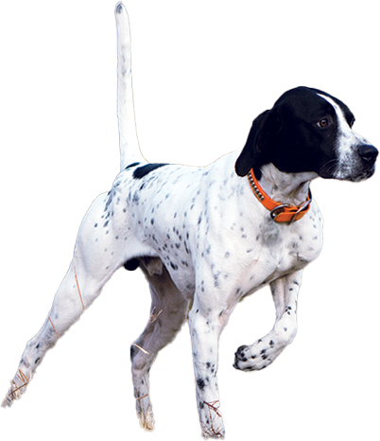

Bird Dog
Set of automation tools to streamline archive acquisition process:
Automate spreadsheet creation and updating
Automate monitoring and reporting of archive page changes
Control the frequency of change reporting
Easy to digest change reporting (embedded in spreadsheet)
Scalable to large number of tracked pages
AI-based classification to highlight entries of high potential interest
Self-serve web app (eventually)

Slide 3
Next Steps
Near term:
AWS deployment
Update to current spreadsheet templates
Testing with Wendy and Juliana
Longer term:
Investigate AI-based classification strategy (e.g. Jewish/non-Jewish)

Slide 4

Ukrainian Jewish Document Archive Automation
March 11, 2025

Slide 5
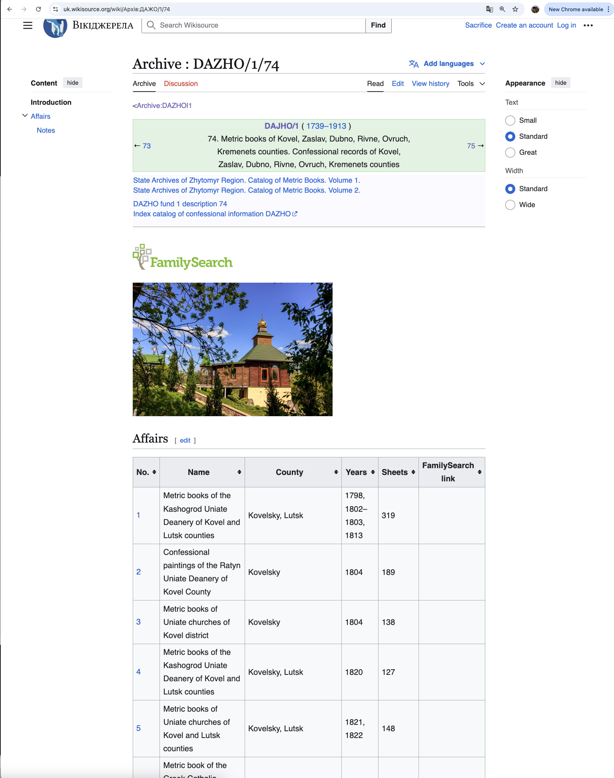
Context
Jewish Gen identifies, captures, and indexes documents from the Ukrainian Wikisource archive.
Focus is on Ukrainian Jewish ancestry research relevance.
Google Sheets is the primary database used to track document processing.
Possible future migration to a more scalable database system is being explored.

Slide 6
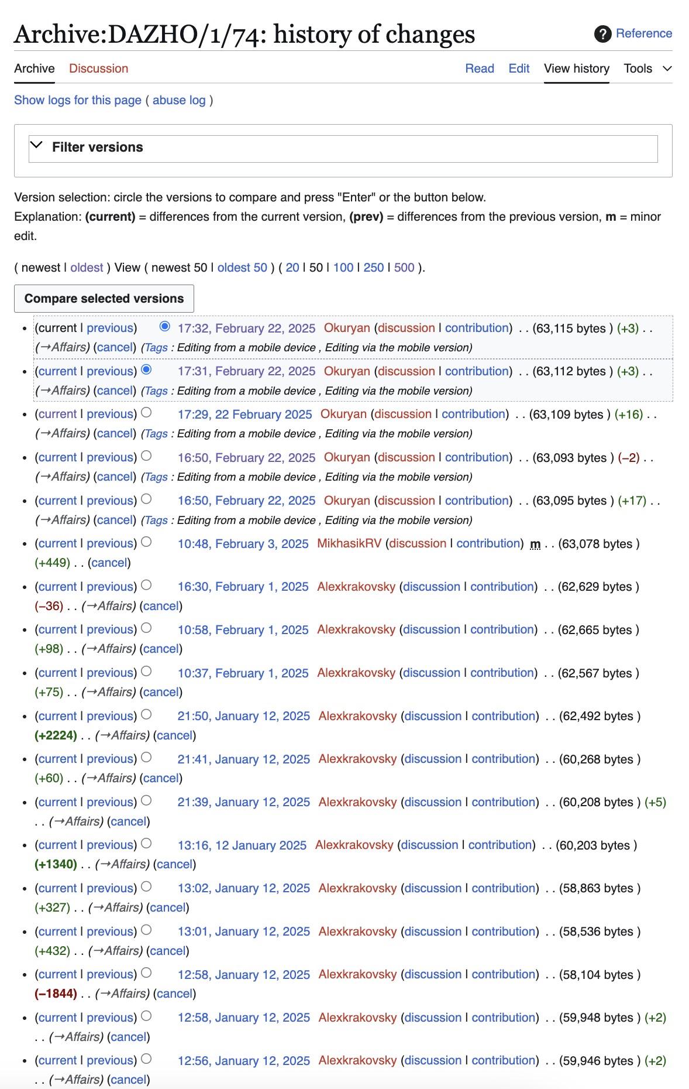
Challenges
Update tracking through wikisource email notifications is too much…
… Too many
… Too frequent
… Too fine-grained
… Too manual
Team is understaffed and this is only one of many responsibilities.
Spreadsheets quickly become out of date.
Wikisource growth seems to be accelerating.

Slide 7

Status
Core functionality in place (limited testing on DAZHO)
Load and cache archive pages (archive, fond, opus)
Translate page contents from Ukrainian to English (Google API)
Get list of all recent changes to a given archive
Retrieve modification history for any given page
Compare changes between any two versions of a page
Export page contents (with highlighted changes) to Excel spreadsheet

Slide 8
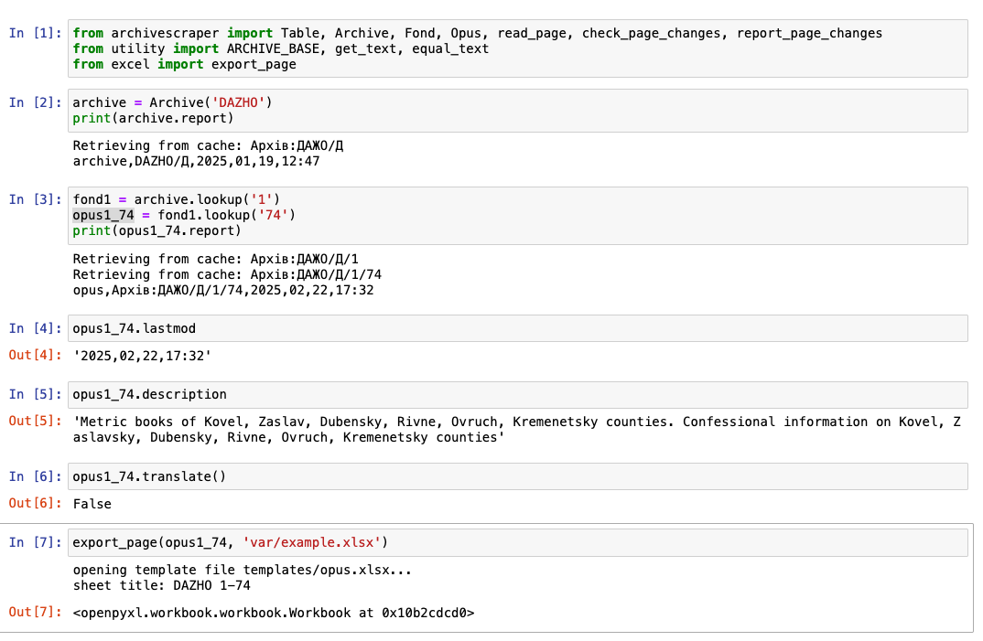
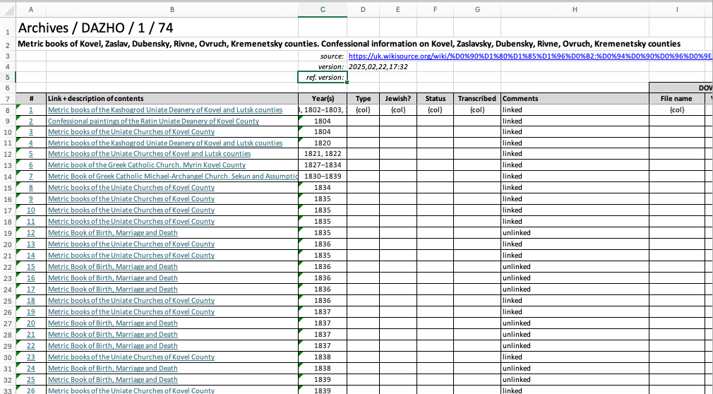
Example: DAZHO/1/74
1. Load DAZHO Archive
2. Load Opus 1/74
3. Translation is not needed (already done).
4. Generate spreadsheet for Opus 1/74

Slide 9
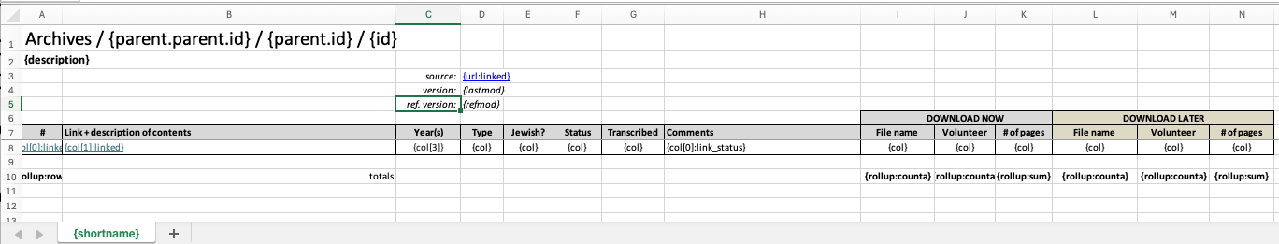
Spreadsheet Templates
Information for a given page is captured from wikisource, optionally translated, and saved in a cache.
The corresponding Excel page is generated from the stored data using a template mechanism.
Spreadsheet format changes can be made to the template and then any number of spreadsheets can be regenerated.
Once the spreadsheets go to Jewish Gen’s system, subsequent changes are not reflected in the cache. The cache is just a local, translated copy of the wikisource page.

Slide 10
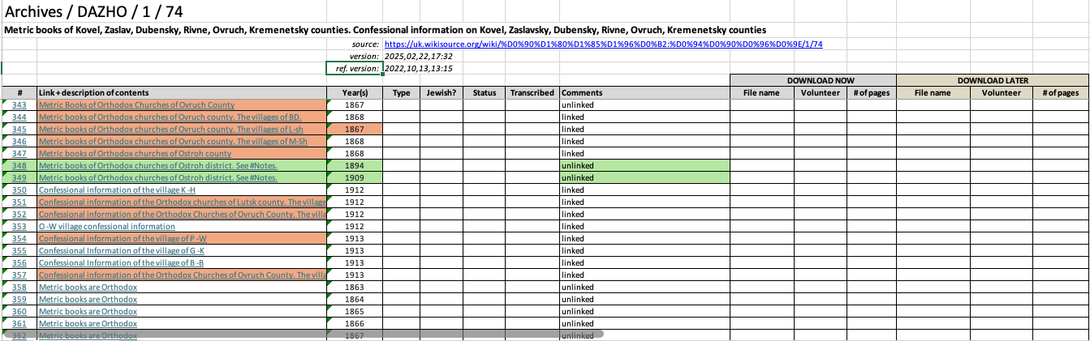
Change Reporting
Wikisource provides the edit history for every page.
This means we can capture and compare with a snapshot of a page from any time in the past.
Changes between the current and a prior version of a page are flagged by highlighting cells in the standard spreadsheet.
Changed
Added

Slide 11
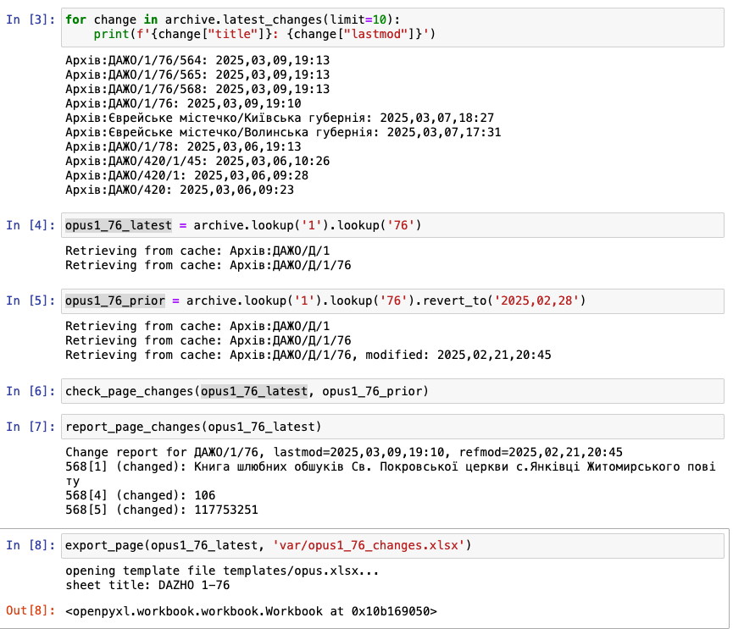
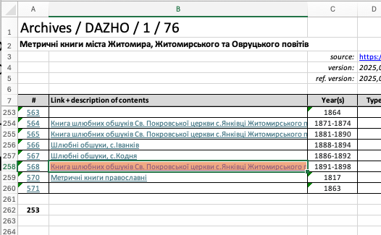
Change Detection
An automatic process can periodically capture a list of all recently edited pages via a wikisource query.
When a change is reported for a given page of interest, a comparison with an earlier version is triggered.
Changes are highlighted with spreadsheet cell colors.

